Slide 1

COMPARATIVE and SUPERLATIVE OF ADJECTIVES

Slide 2
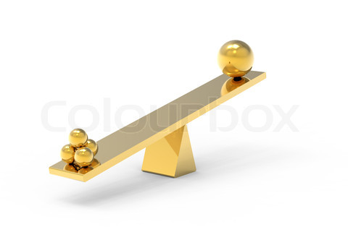
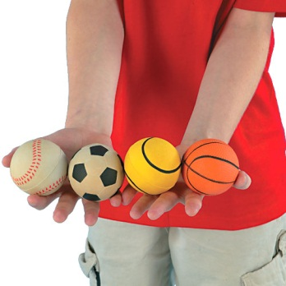
To compare the qualities of two people or things,
we use comparative adjectives.
adjective + er
To compare a person or thing within a group,
we use superlative of adjectives.
the adjective + est

Slide 3
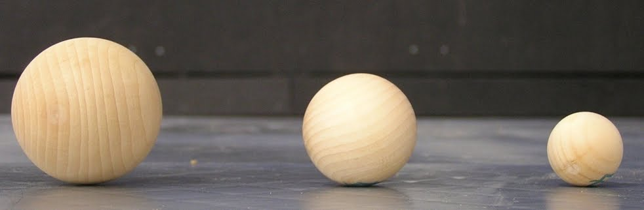
Small
Smaller
The Smallest

Slide 4
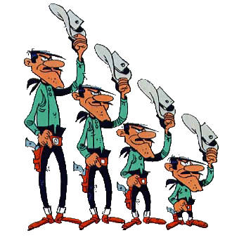
Tall
Short
Shorter
The Shortest

Slide 5
COMPARATIVE ADJECTIVES
Adjectives with one syllable or two syllables but end in –y → +er
small + er
heavy + er
heavier
tall + er
lucky + er
luckier
cold + er
easy + er
easier
light + er
one syllable
two syllables end in -y

Slide 6
COMPARATIVE ADJECTIVES
(a,e,i,o,u)
(b,c,d,f,g,h,j,k...)
One syllable adjectives that end in a vowel + a consonant
big + er
bigger
hot + er
hotter
sad +er
sadder
one syllable end in one vowel + one consonant

Slide 7
COMPARATIVE ADJECTIVES
Adjectives with two or more syllables
useful
more useful
MORE
beatiful
more beatiful
interesting
more interesting
2 or more syllables

Slide 8
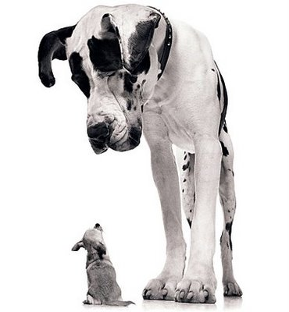
COMPARATIVE ADJECTIVES
To make comparation we add « than »
Alfa
Ace
Ace is smaller than Alfa.

Slide 9
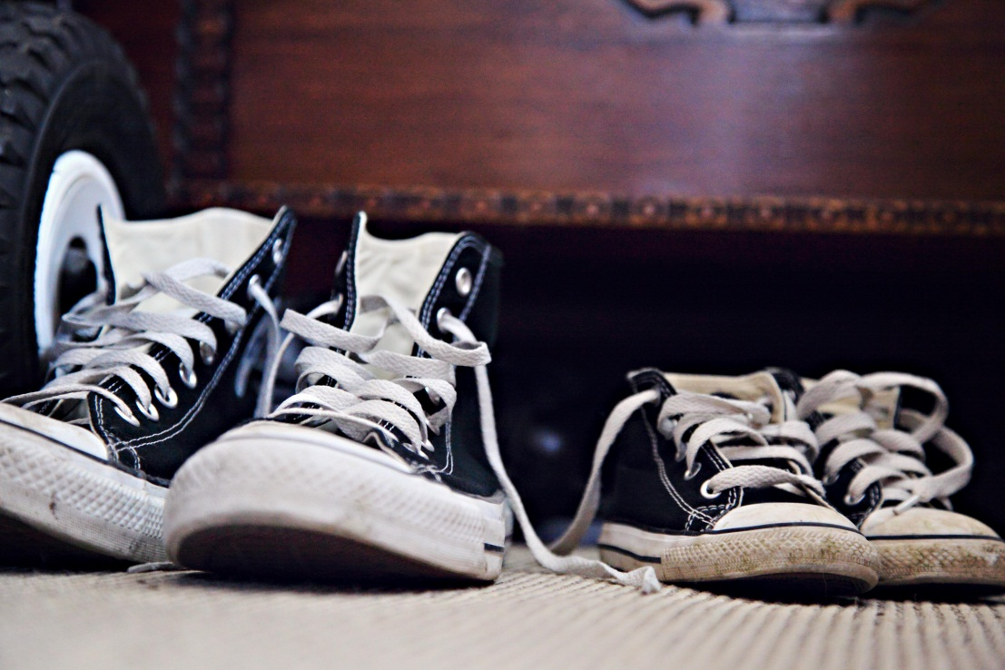
COMPARATIVE ADJECTIVES
To make comparation we add « than »
John’s shoes
Kate’s shoes
John’s shoes are bigger than Kate’s shoes.

Slide 10
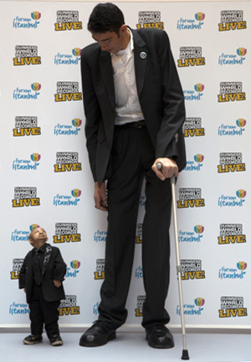
Bao
Pingping is shorter than Bao.
Bao is taller than Pingping.
Tall
Short
Pingping

Slide 11
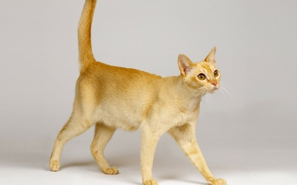
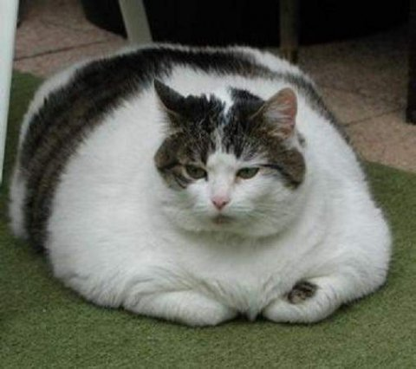
Yellow cat is thinner than white cat.
White cat is fatter than yellow cat.
Thin
Fat

Slide 12
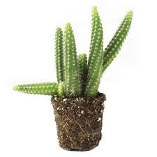
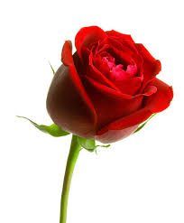
Ugly
Cactus is uglier than rose.
Rose is more beatiful than cactus.
Beatiful

Slide 13
COMPARATIVE ADJECTIVES
Irregular adjective forms
good
better
bad
worse
far
farther/further
much
more
little
less
irregular forms

Slide 14
SUPERLATIVE ADJECTIVES
Adjectives with one syllable or two syllables but end in –y → +er
small + est
heavy + est
heaviest
tall + est
lucky + est
luckiest
cold + est
easy + est
easiest
light + est
one syllable
two syllables end in -y

Slide 15
SUPERLATIVE ADJECTIVES
(a,e,i,o,u)
(b,c,d,f,g,h,j,k...)
One syllable adjectives that end in a vowel + a consonant
big + est
biggest
hot + est
hottest
sad +est
saddest
one syllable end in one vowel + one consonant

Slide 16
SUPERLATIVE ADJECTIVES
Adjectives with two or more syllables
useful
most useful
MOST
beatiful
most beatiful
interesting
most interesting
2 or more syllables

Slide 17
SUPERLATIVE ADJECTIVES
Irregular adjective forms
good
better
the best
bad
worse
the worst
far
farther/further
the farthest /furthest
much
more
the most
little
less
the least
irregular forms

Slide 18
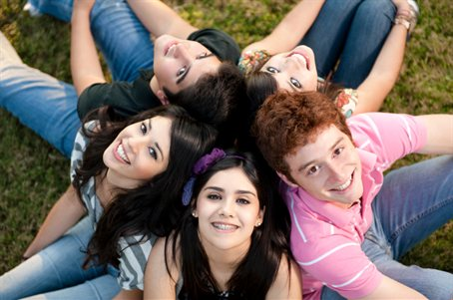
Betty
Jane
Kate
Kate is the most beatiful girl in the group.

Slide 19

Henry
John
Mary
Kate
Suzy
Lil
Henry is the most hardworking student in the class.

Slide 20
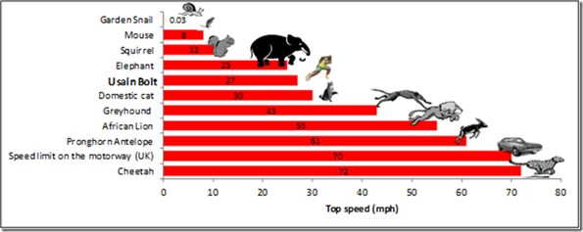
Cheetah is the fastest animal in the world.

Slide 21

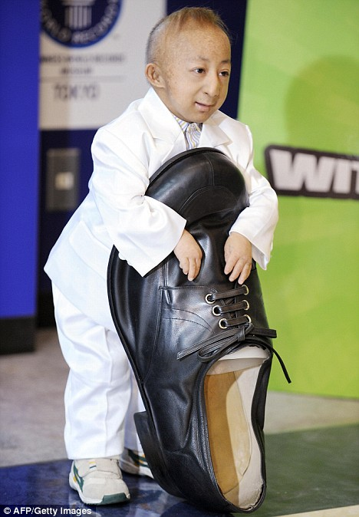
as + adjective + as
To say that people,things are equal in some way,
we often use this structure.
Pingping is as big as a shoe.

Slide 22
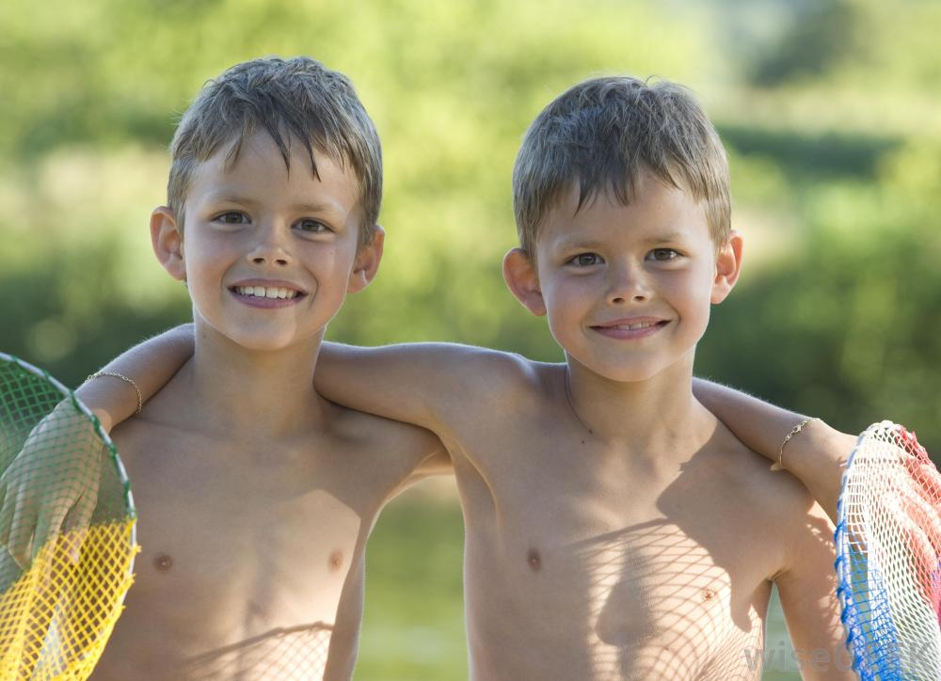
as + adjective + as
To say that people, things are equal in some way,
we often use this structure.
Johny
David
Johny is as tall as David.

Slide 23
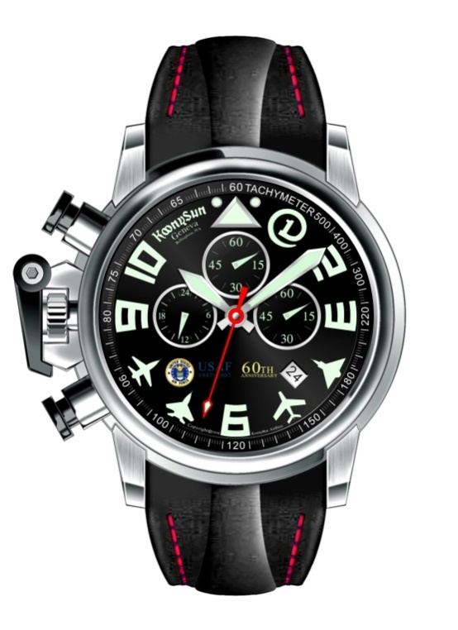
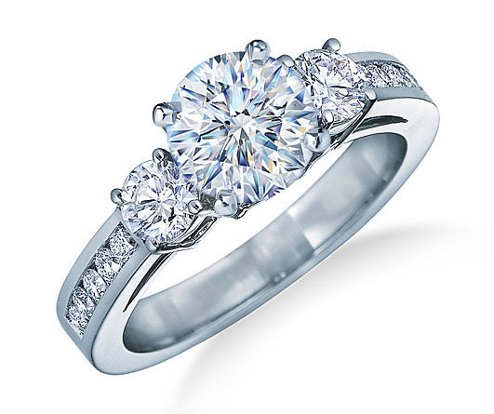
Both the watch and the ring are £120.
The ring is as expensive as the watch.

Slide 24
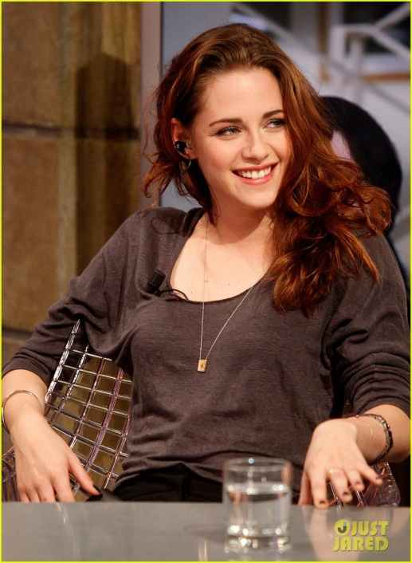
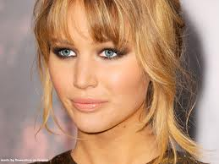
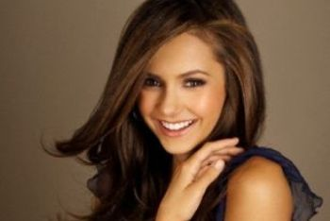
Who is the most successful actress in the world?
I think Jennifer Lawrence is the most successful
actress in the world.

Slide 25
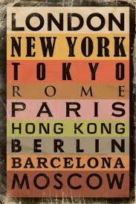

What is the largest city in the world?
Tokyo is the largest city in the world.

Slide 26
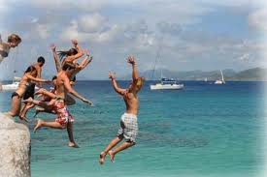
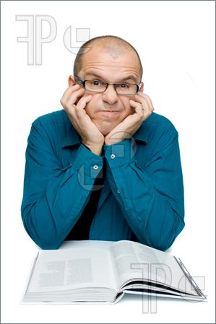
less and the least
Adults are less adventurous than teenagers.

Slide 27
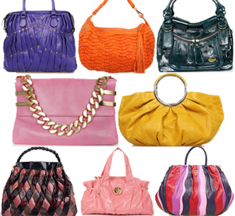
less and the least
This bag is the least expensive in the store.

